Slide 1
NATIONAL REPORT ON THE IMPLEMENTATION OF THE EUROPEAN LANGUAGE LABEL BELGIUM
Anca Cristina Colibaba, Monica Vlad
EuroEd Foundation, Romania
acolib@euroed.ro
monica.vlad@euroed.ro
With the support of Renilde Reynders, in-charge of the European Language Label at EPOS (the National Agency responsible for the implementation of the European Life Long Learning Programme in Flanders)

Slide 2
Introduction to the European Language Label at national level
Research approaches:
top-down (analysis of institutions, responsibilities, actions implemented)
bottom-up (follow-up on projects)
Notes:
Firstly, a top-down approach aiming to identify the national actions carried out in order to implement the ELL. This first part of the report includes: the identification of the national institutions in-charge of the ELL in Belgium, the description of the specific responsibilities assigned to each of those institutions, the national organization of the Label campaigns, the national priorities and the selection criteria, the statistics about awarded projects, the evaluation and the follow-up of some of the awarded projects.
Secondly, a bottom-up approach aiming to carry out a follow-up of projects that were awarded the ELL in Belgium. This second part of the report includes: the impact of the European Label on the awarded projects, the activities of dissemination and exploitation carried out by the awarded project promoters, the recommendations coming from the awarded project promoters in order to improve the ELL initiative.

Slide 3
The European Language Label in Belgium
Three agencies (the German, French and Flemish communities):
Die Agentur für Europäische Bildungsprogramme – for the German-speaking community
AEF - Agence Francophone pour l'Education et la Formation tout au long de la vie – for the French-speaking community
Europese Programma’s voor Onderwijs, Opleiding en Samenwerking (EPOS vzw) – for the Flemish community

Slide 4
The Label Campaigns
Different promotion and dissemination strategies:
The agency for the German-speaking community: a Vorbereitungsseminar (a preparatory seminar) which covers an introduction in the concept behind the award of the ELL and specific sessions for the theme of the respective year
A valorization brochure (French-speaking community)
Publication of information brochures or leaflets, aiming at presenting the European Language Label (German-speaking community and Flemish community)
Notes:
The agency for the German-speaking community: a Vorbereitungsseminar (a preparatory seminar) which covers an introduction in the concept behind the award of the ELL and specific sessions for the theme of the respective year . For example, for the 2012 theme, one session was entitled “From the language lab to Facebook. Are teachers now redundant?”, another one was “How are teacher trainees trained for the usage of new technologies in the classroom?”. The preparatory seminar also included a discussion on the topic and a session on practical issues related to the application procedure.
The agencies in-charge for offering the ELL within the French-speaking community have put together in 2012 a valorization brochure which includes a series of projects awarded since 1997. The projects have been selected based on their actuality and transferability into current contexts.
Publication of information brochures or leaflets, aiming at presenting the European Language Label. The brochures inform about the benefits offered by the European Language Label, inform about European policies on multilingualism and present some of the Belgian projects that were awarded the European Language Label. See, for example, the leaflet produced by the agency in-charge of the German-speaking community at:
http://www.dglive.be/agentur/PortalData/16/Resources/downloads/260312_AGENT_SPRACHENSIE.12.pdf
The leaflet of the Flemish community can be found at: http://www.epos-vlaanderen.be/?CategoryID=457&ArticleID=721
In the Flemish community, the information brochure contains also explanation on the theme, the selection and eligibility criteria and the national (Flemish) priorities, information about the jury, the selection procedure, the application form etc.

Slide 5
Priorities
The Belgian agency for the Flemish community has listed the following national priorities since 2006:
1. Improving participation in language learning of groups at risk
2. Raising awareness about language learning
3. Project focusing on (and/or): communicative, interactive and intercultural competences

Slide 6
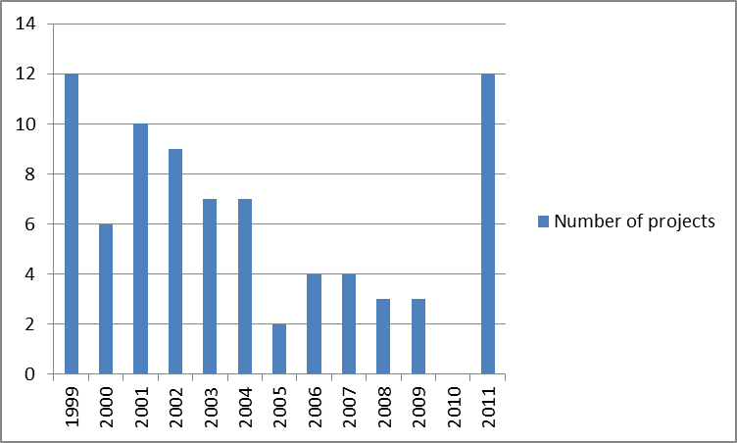
Awarding the European Language Label
Source: European Commission, Languages (http://ec.europa.eu/education/language/label/index.cfm)
Notes:
Between 1999 and 2011, 79 projects have been awarded the European Language Label in Belgium. The statistical data, collected by the NELLIP team, offer a synthetic image about some strategic points: the awarded projects year by year, the educational sectors and the themes for which they have been awarded. These statistics include only the projects that have been uploaded in the European database:
This statistics also shows that in Belgium an average of six projects a year have been awarded the label in between 1999 and 2011.

Slide 7
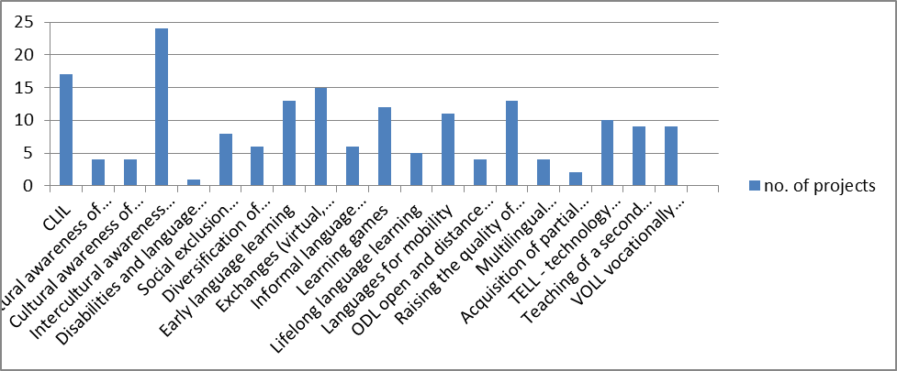
Awarding the European Language Label – thematic areas
Source: European Commission, Languages (http://ec.europa.eu/education/language/label/index.cfm)
Notes:
The graphic above shows that among projects that have been awarded the label in Belgium the best represented educational areas are CLIL, intercultural awareness, early language learning, exchanges, learning games, languages for mobility and raising the quality of language teaching / learning.
All areas in full text:
CLIL Cultural awareness of regional / minority languages Cultural awareness of migrant languages Intercultural awareness (any language Disabilities and language learning Social exclusion disadvantaged learners Diversification of languages on offer Early language learning Exchanges (virtual, physical) Informal language learning Learning games Lifelong language learning Languages for mobility ODL open and distance learning Raising the quality of language teaching / learning Multilingual comprehension Acquisition of partial language skills TELL - technology enhanced language learning Teaching of a second language VOLL vocationally oriented language learning

Slide 8
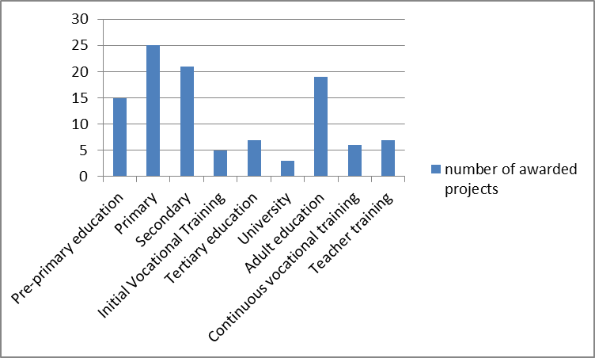
Awarding the European Language Label – thematic areas – educational sectors
Source: European Commission, Languages (http://ec.europa.eu/education/language/label/index.cfm)

Slide 9
Evaluation carried out by the NELLIP Team
31 projects selected for the NELLIP database
8 case studies
4 best practice examples (school, VET, adult education and transversal)
projects coordinators were interviewed using an online questionnaire
Notes:
According to this further classification, the higher number of selected case studies belongs to the School Education sector, followed by the Vocational Education and Training sector. Few case studies belong to the higher education sector, and even fewer were addressed to a target group composed by adult learners

Slide 10
Impact and Exploitation of the European Language Label as assessed by the NELLIP Team
the project has acquired a greater visibility
the prestige of the school/organization was raised
the coordinators had the opportunity to share a good practice (e.g. in teacher training)
some beneficiaries (teachers, teacher trainers) have decided to change their teaching practices (in testing and assessment for example)
the project obtained recognition in an area where there are not a lot of awards (as one VET project coordinator stated)
the ELL gave authenticity to their school offer

Slide 11
Best Practices
selected projects can be used as examples and benchmarks for the development of future quality language projects
best practice examples were also identified at the level of the Belgian agencies (valorization and promotion brochures, preparation activities, embed the ELL award ceremony within other events with wider coverage)

Slide 12
Recommendations
Include national priorities to maximize the linguistic context of the country
Encourage priorities to exploit the languages spoken in the family
Encourage projects that illustrate a language-friendly environment
Support projects that develop methodologies for partial understanding
Highlight projects that show how language use is important for professional development or social cohesion.
Raise awareness on the European Language Label’s impact

Slide 13
Procedural
Only one single logo should be used for the ELL at transnational level
Clear guidelines on the use of the logo are needed
The certificate should continue to be signed by the European Commission but it should be the same for the countries involved
Notes:
Clear guidelines on the use of the logo are needed(e.g. what does it mean, when and where can it be used, is it for the whole organization or just for the project or theme that received the award, for how long can it be used etc.).

Slide 14
Conclusions
ELL has a good impact on the awarded projects
Most coordinators decide to apply for the ELL for improving the visibility of their projects
Benefits of the ELL are not always clear
The Label is not sufficiently known and recognized
In the future, follow-up activities for the Label should be envisaged (e.g. valorization brochures)
The promotion of opportunities for transnational networking and sharing should be more actively pursued

